Slide 1

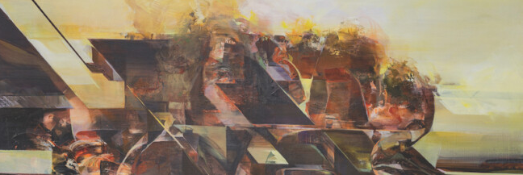

Slide 2
Reflection Activity –Statistically Speaking
How can visual systems like repetition, pattern, and mapping communicate data or experience without using numbers or words?
What role does abstraction play in helping artists convey personal, cultural, or environmental information?
How do the artists studied transform real-world data into symbolic visual language?
Which stage of the inquiry process (developing, researching, reflecting, resolving) do you think is most important when creating an artwork based on data?

Slide 3
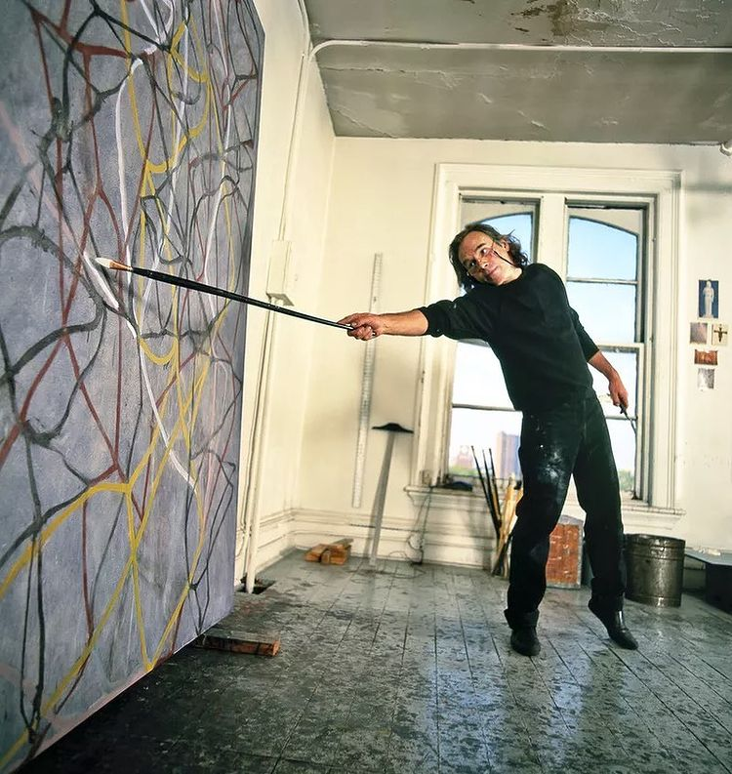
PRACTICAL ACTIVITY
Task: Create a large-scale gestural artwork that expresses a personal emotion or memory through physical movement and mark-making.
Objective: To explore how data from the body—such as rhythm, energy, and emotion—can become abstract visual language.
Instructions:
Reflect on a powerful emotional experience or moment.
Use extended tools (sticks, sponges, rags) to create marks with your full body.
Choose expressive media such as house paint, charcoal, ink, or pastel.
Let rhythm, energy, and gesture guide the mark-making—avoid literal imagery.
Optional: Respond to a piece of music. Let sound and tempo influence your movement.
Reflection: Annotate your final work with the meaning behind your marks. What emotion was behind each gesture?
What does emotional energy look like as a pattern or trace? How can your gestures become a visual code?
Cultural Context: How can personal experience or emotion become a form of embodied visual data?
Formal Context: How do scale, line, and physicality influence composition and energy?

Slide 4
Researching: How did you react to stimulus?
Insert clear image of artwork
Crop the image to frame the work (nothing in the background)
Developing: How did you generate solutions to visual problems? Insert a photograph/s detail of the artwork below
Reflecting: How did you consider ideas and information, media techniques and processes?
Evaluate: How successful was the experiment? Why?

Slide 5
PRACTICAL ACTIVITY
Task:reate a resolved artwork that transforms personal or collected data into an abstract pattern, composition, or surface.
Objective: To explore how information—numerical, behavioural, physical, cultural—can become visual code through repetition and structure.
Instructions:
Choose a dataset: e.g. daily habits, family statistics, cultural stories, environmental measurements
Translate that information into a pattern using repetition, shape, scale, or movement
Avoid literal representation—focus on structure, layering, and meaning
Use any medium: digital art, drawing, painting, or time-based media
Visual Journal Requirements:
Initial notes on data or behaviour selected
Symbol or pattern development
Experiments with structure and repetition
Reflection on how the data has been transformed into art
Formal Context: How does visual structure and organisation influence the viewer’s experience? Cultural Context: What does your data reveal about identity, place, or society?
Prompt: What are the invisible systems that shape your life? What might they look like as art?

